Slide 1
UNIT 3-S2 DISPLAY DEVICES,LIGHT SOURCES AND DETECTION DEVICES

Slide 2
Cathode-luminescence
Cathode-luminescence is produced by an energized cathode which generates a beam of high-energy bombarding electrons. Ex.: Applications of this include electron microscope; cathode-ray oscilloscope; color television screens.
The modern televisions have very narrow, about 0.25 mm wide, vertical stripes of red-, green-, and blue- emitting phosphors deposited on the inner surface of the screens.
Commercial phosphors for different colors are: red – yttrium oxy-sulfide (Y₂O₂S) with 3% europium (Eu); green – (Zn,Cd)S with a Cu⁺ acceptor and Al³⁺ donor; blue – zinc sulfide (ZnS) with Ag⁺ acceptor and Cl⁻ donor.

Slide 3
Cathodoluminescence
Cathodoluminescence is an optical and electromagnetic phenomenon in which electrons impacting on a luminescent material such as a phosphor, cause the emission of photons which may have wavelengths in the visible spectrum.
A familiar example is the generation of light by an electron beam scanning the phosphor-coated inner surface of the screen of a television that uses a cathode ray tube.
Cathodoluminescence is the inverse of the photoelectric effect, in which electron emission is induced by irradiation with photons.

Slide 4
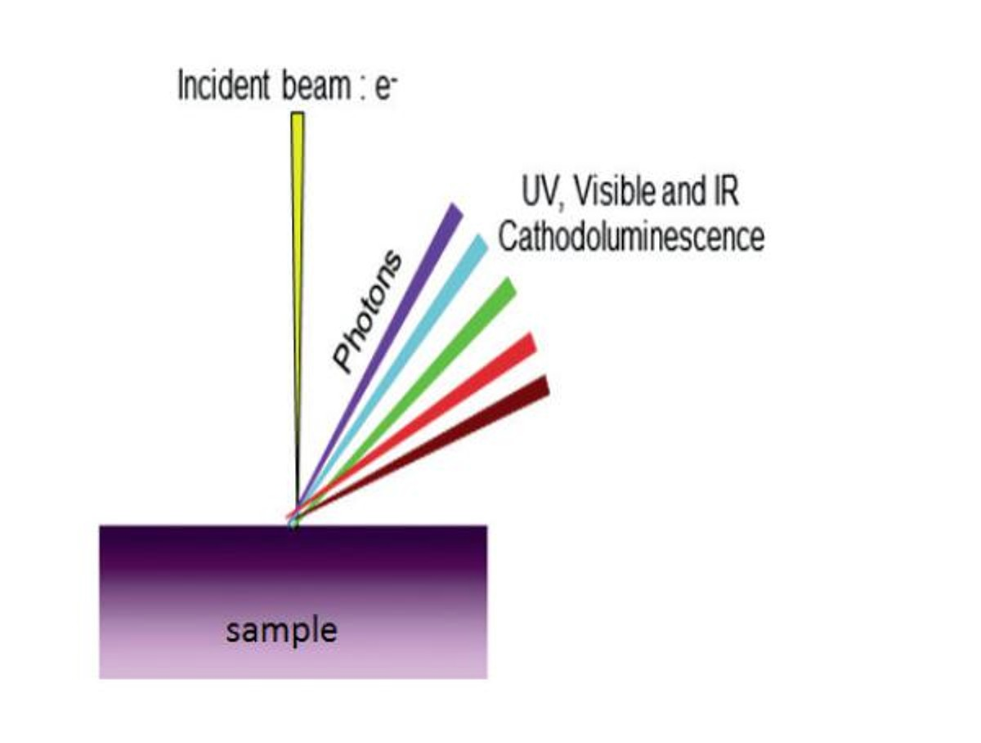

Slide 5
Luminescence in a semiconductor results when an electron in the conduction band recombines with a hole in the valence band. The difference energy (band gap) of this transition can be emitted in form of a photon.
The energy (color) of the photon, and the probability that a photon and not a phonon will be emitted, depends on the material, its purity, and the presence of defects.
First, the electron has to be excited from the valence band into the conduction band. In cathodoluminescence, this occurs as the result of an impinging high energy electron beam onto a semiconductor.
However, these primary electrons carry far too much energy to directly excite electrons. Instead, the inelastic scattering of the primary electrons in the crystal leads to the emission of secondary electrons, Auger electrons and X-rays, which in turn can scatter as well. Such a cascade of scattering events leads to up to 10³ secondary electrons per incident electron.
These secondary electrons can excite valence electrons into the conduction band when they have a kinetic energy about three times the band gap energy of the material.s
From there the electron recombines with a hole in the valence band and creates a photon. The excess energy is transferred to phonons and thus heats the lattice.

Slide 6
Cathodoluminescence Applications
Cathodoluminescence emission can be used to explore many fundamental properties of matter.
It can be used to study light transport, scattering, electronic structure of materials, including semiconductors, (e.g. bandgap, defects), resonant phenomena.
Cathodoluminescence imaging is also an ideal tool to study geological samples. The CL emission from a rock gives insights into crystal growth, zonation, cementation, replacement, deformation, provenance, trace elements, and defect structures

